Slide 1
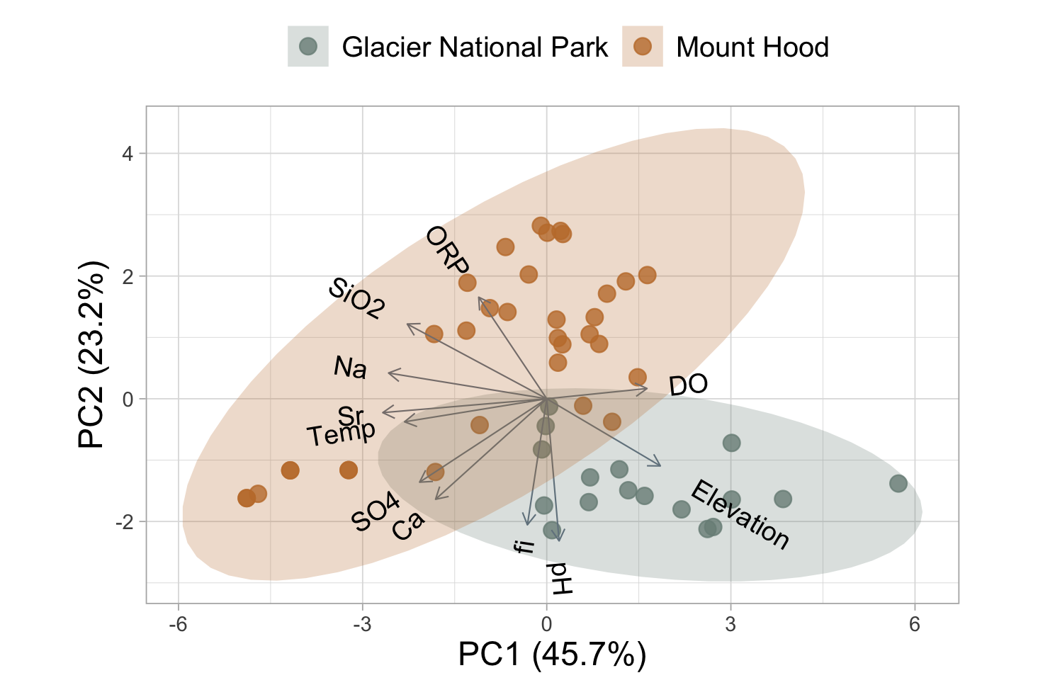
Warm springs (4)

